Slide 1

INTERNSHIP PRESENTATION
FRIEDRICH SCHILLER UNIVERSITY JENA
FACULTY OF PHYSICS AND ASTRONOMY
INSTITUTE FOR SOLID STATE THEORY AND OPTICS
Effect of Localized Rotation Errors on the
Deutsch–Jozsa Algorithm
Submitted in partial fulfillment of the requirements for the Internship Module
SUPERVISOR
PROJECT ADVISOR
Prof. Dr. Martin Gärttner
Niklas Euler
Presented by
Abiy Zelalem Tegegne
Jena, Germany • August 2026

Slide 2
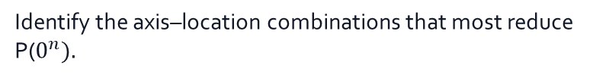
Motivation of the Study
Why error location matters
Research problem
Study focus
•
Quantum algorithms depend on precise gates oprtsations.
•
Compare localized Rₓ(θ), Rᵧ(θ), and Rz(θ) errors.
•
A coherent over-rotation can accumulate systematically instead of averaging away.
•
Test four physically meaningful locations, E₁–E₄.
•
The same rotation may be harmless at one stage but destructive at another.
•
Identify the axis–location combinations that most reduce P($0^{n}).$
Motivation
Mechanism-matched mitigation requires knowing both what the error is and where it acts.
02

Slide 3
Objectives of the Study
The study separates axis, angle, and location
1
Model
Implement coherent single-qubit rotations Rₓ(θ), Rᵧ(θ), and Rz(θ).
2
Localize
Insert each error separately at E₁, E₂, E₃, and E₄.
3
Measure
Sweep θ and evaluate the probability P(0ⁿ).
4
Compare
Identify robust and vulnerable stages of the algorithm.
03

Slide 4
The Deutsch–Jozsa Problem
f : {0,1}ⁿ → {0,1}
Boolean Function
Constant
Balanced
f(x) has the same value
for every input x.
f(x) = 0 for half the inputs
and f(x) = 1 for the other half.
Task
Determine with certainty whether the function is constant or balanced.
04

Slide 5
Continued…
Quantum interference compresses many function values into one query
To decide with certainty
Classical deterministic(worst case)
Deutsch–Jozsa quantum algorithm
2ⁿ⁻¹ + 1
1
oracle query
oracle queries in the worst case
The advantage comes from superposition and interference—not from reading every f(x).
05

Slide 6
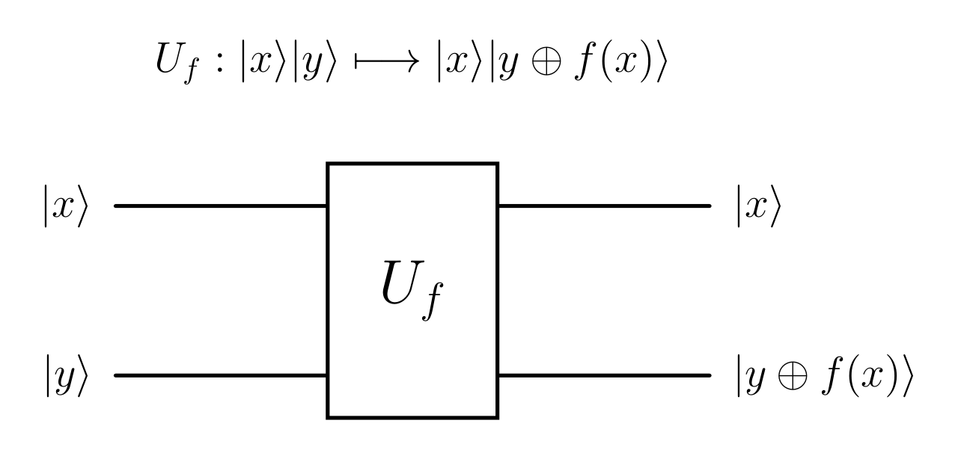
Oracle Representation
The oracle stores f(x) reversibly
x is unchanged; the ancilla changes from y to y ⊕ f(x). One passage through $U_{f}$ is one oracle query.
06

Slide 7
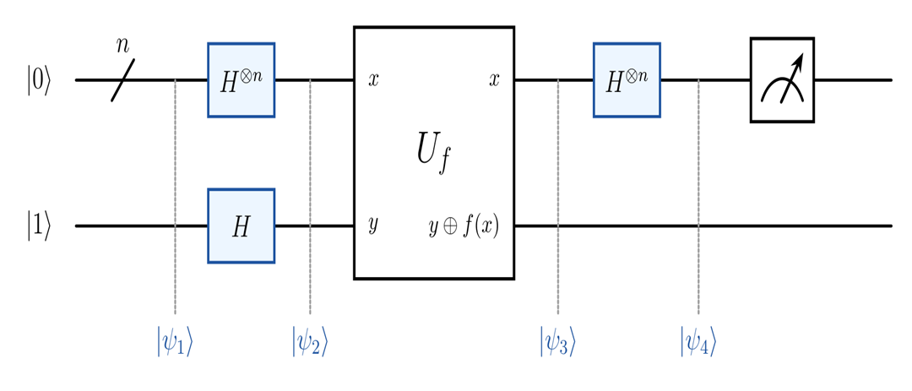
Ideal Deutsch–Jozsa Circuit
The ideal circuit converts phase structure into a binary decision
Decision rule
Constant
P(0ⁿ) = 1
Balanced
P(0ⁿ) = 0
Circuit logic
Superposition → oracle phase encoding → interference → measurement
07

Slide 8
How One Query is Decoded
Interference creates the all-zero signature
1
2
3
4
Prepare
Superpose
Encode
Interfere
|0⟩ⁿ|1⟩
H creates all 2ⁿ inputs
oracle adds phases (−1)ᶠ⁽ˣ⁾
final H combines amplitudes
Output
Constructive interference at | 0ⁿ ⟩ signals constant; cancellation at |0ⁿ⟩ signals balanced.
08

Slide 9

Rotation-Axis
Three coherent rotations model axis-specific gate miscalibration
Rₓ(θ)
Rᵧ(θ)
$R_{Z}($θ)
exp(−iθX/2)
exp(−iθY/2)
exp(−iθZ/2)
Bit-axis rotation
Mixed bit–phase rotation
Phase-axis rotation
Coherent error
A fixed unitary over- or under-rotation; θ controls its magnitude and the axis controls its mechanism.
09

Slide 10
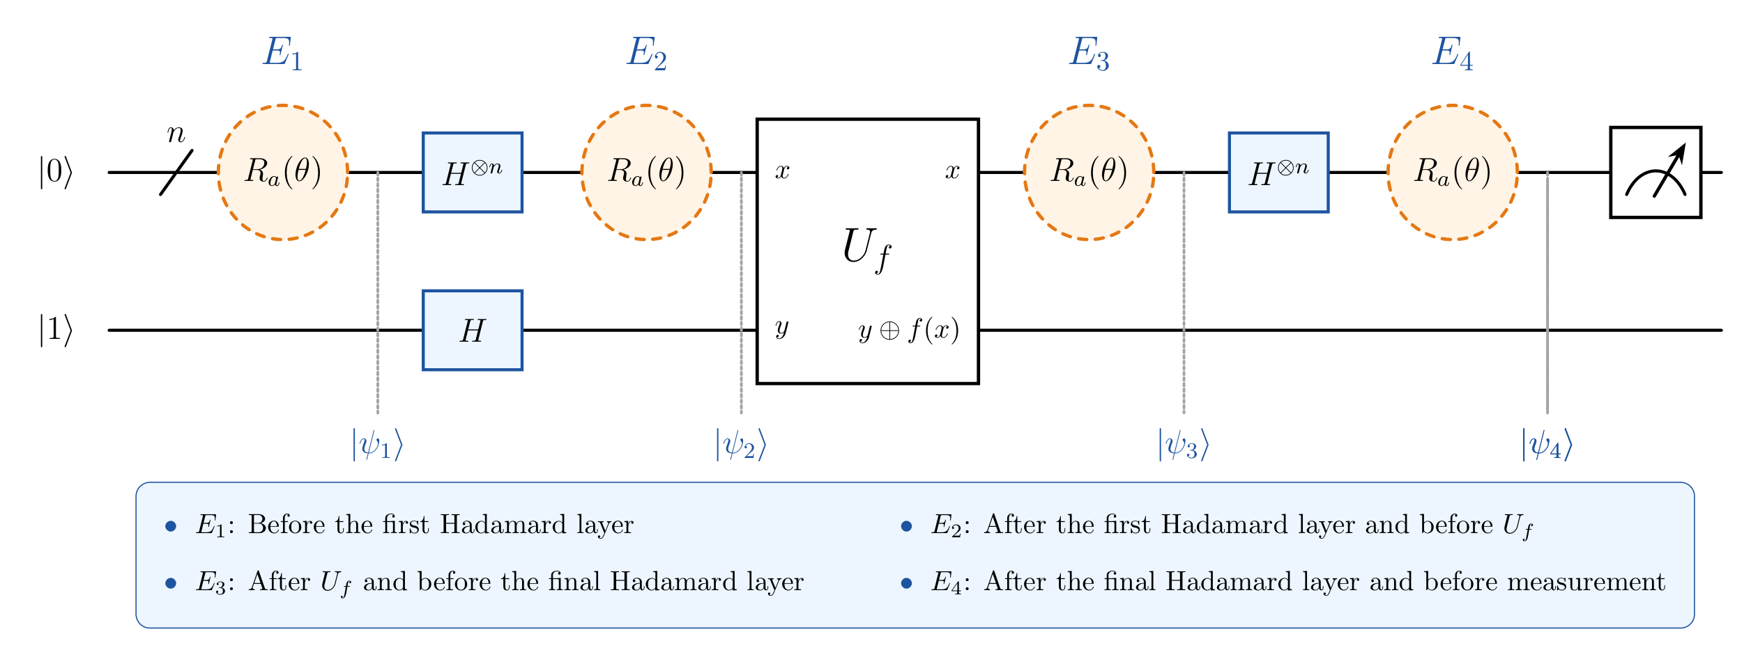
Localized Error Positions
Four locations isolate when the same rotation acts
10

Slide 11
Simulation Methodology
Error implementation
Simulation parameters
•
Apply one localized rotation to one selected data qubit.
•
Input qubits: n ∈ {1, 3, 5, 7, 9}; target q=⌊n/2⌋.
•
Test Rₓ(θ), Rᵧ(θ), and Rz(θ) separately.
•
Angle: 0°–180° in 20° increments.
•
Repeat independently at E₁, E₂, E₃, and E₄.
•
1024 measurement shots per circuit execution.
A controlled sweep holds everything else fixed
Environment
Python • NumPy • SciPy • Matplotlib • JupyterLab • Git
11

Slide 12
Simulation workflow
Every trial produces one comparable success probability
1
2
3
4
5
→
→
→
→
Choose n, axis, location
Choose θ
Build and execute circuit
Repeat 1024 shots
Calculate P(0ⁿ)
Performance metric
P(0ⁿ) = N(0ⁿ) / 1024
Fraction of shots that produce the all-zero data register
12

Slide 13
Results and Discussion
Sensitivity is an axis–location interaction
Nine plots test two constant functions and one balanced function across X, Y, and Z rotations.
X
E₁ and E₄
Y
All locations
Z
E₂ and E₃
13

Slide 14
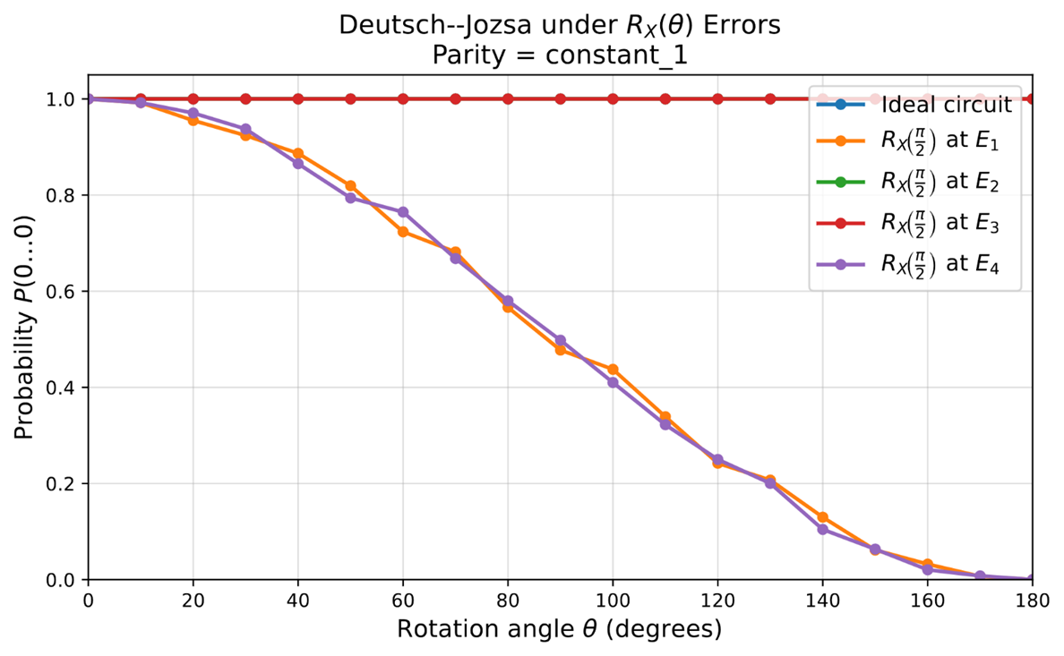
Continued…
X-axis rotation
•
E₁ and E₄ degrade together from P(0ⁿ)≈1 toward 0.
•
E₂ and E₃ remain close to the ideal curve.
•
At intermediate stages, X-basis eigenstates turn the rotation mainly into phase.
Most sensitive: state preparation and pre-measurement
Each plotted rotation uses the angle sweep θ = 0°…180°
14

Slide 15
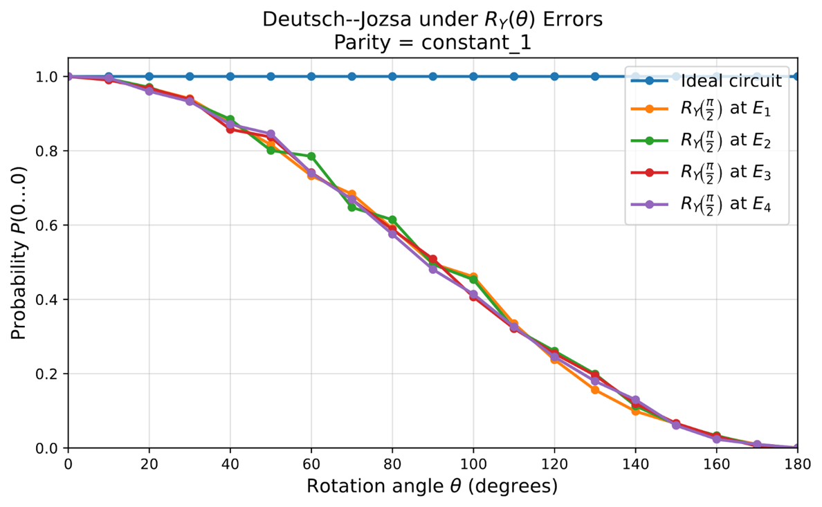
Continued…
Y-axis rotation
•
All four error-location curves nearly overlap.
•
P(0ⁿ) decreases steadily as θ approaches 180°.
•
Rotation angle dominates; no location is substantially protected.
Uniform location sensitivity
Each plotted rotation uses the angle sweep θ = 0°…180°
15

Slide 16
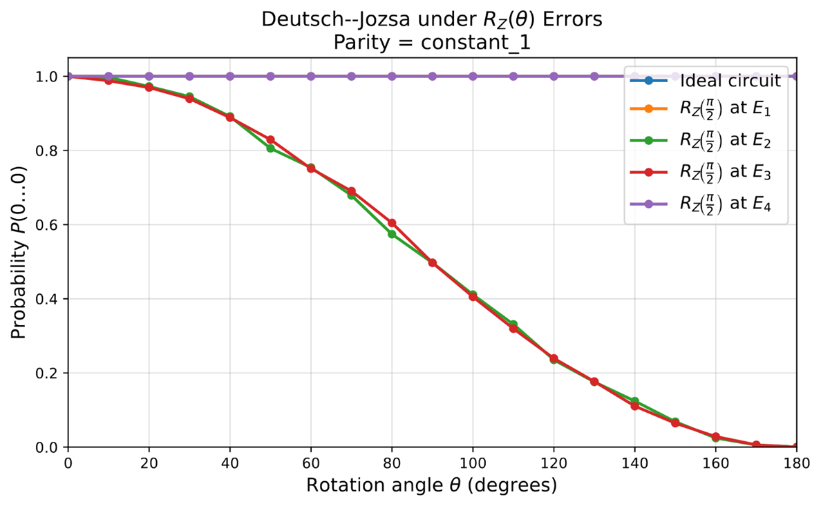
Continued…
Z-axis rotation constant f(x)=1, Z rotations target E₂ and E₃
•
E₁ and E₄ remain essentially ideal.
•
E₂ and E₃ lose success probability as θ increases.
•
Relative phase changes inside the interference region alter the final outcome.
Most sensitive: oracle input and oracle output
Each plotted rotation uses the angle sweep θ = 0°…180°
16

Slide 17
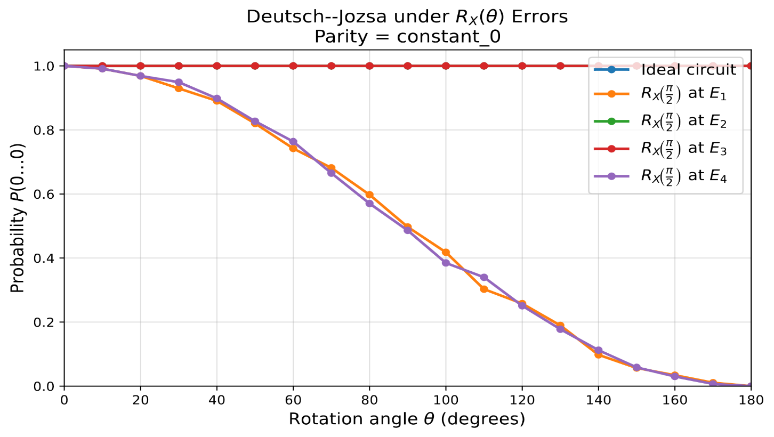
Continued…
X-axis rotation · Constant f(x)=0
•
E₁ and E₄ again show the dominant degradation.
•
E₂ and E₃ remain near the ideal result.
•
The location pattern is not specific to the constant output value.
Robust pattern across both constant functions
Each plotted rotation uses the angle sweep θ = 0°…180°
17

Slide 18
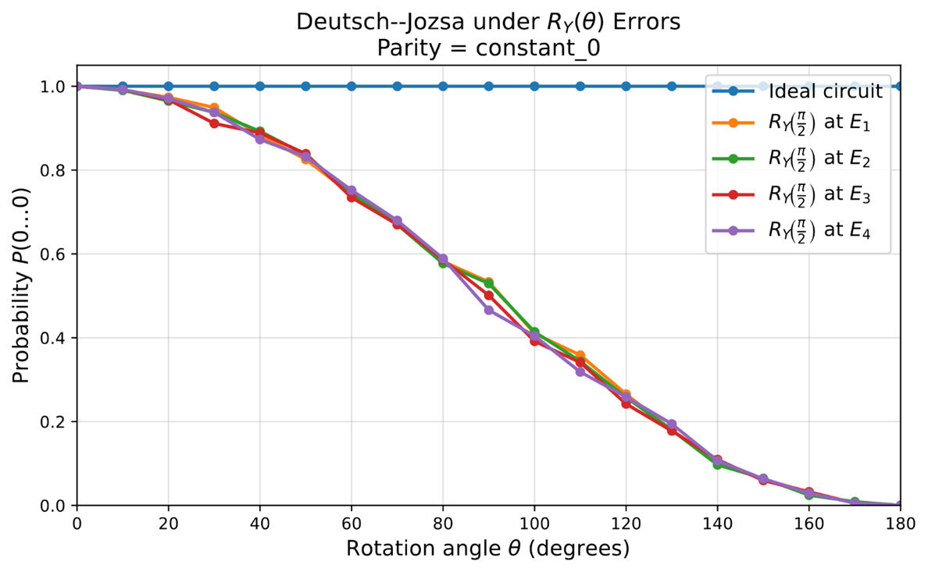
Continued…
Y-axis rotation · Constant f(x)=0
•
All locations decrease along nearly the same trajectory.
•
Differences are consistent with finite-shot fluctuations.
•
Angle remains more important than position for Y rotations.
Y response is location-independent
Each plotted rotation uses the angle sweep θ = 0°…180°
18

Slide 19
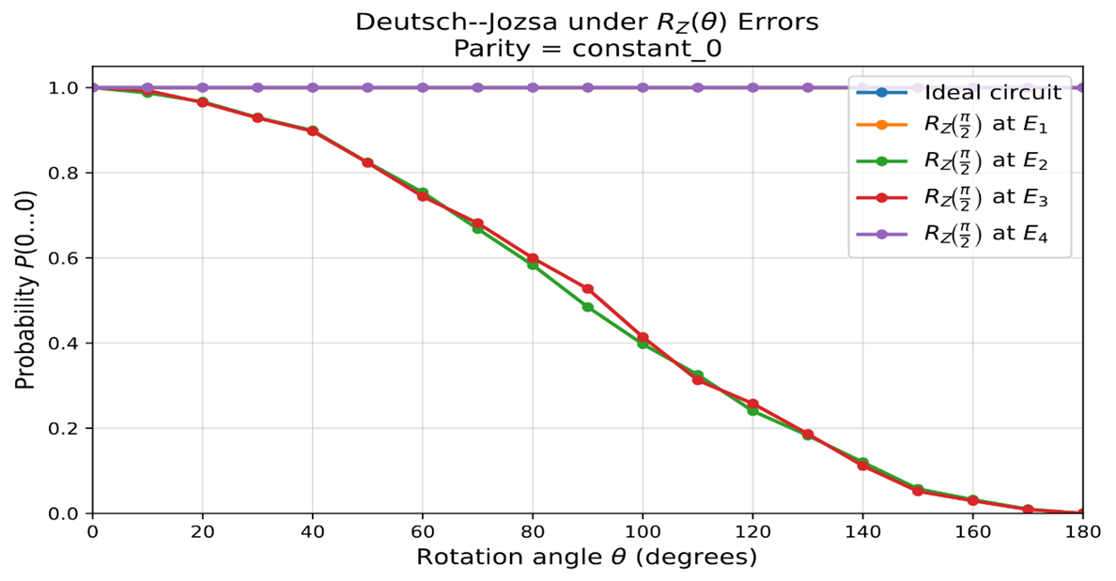
Continued…
Z-axis rotation · constant 0
•
E₂ and E₃ are again the vulnerable positions.
•
E₁ and E₄ stay near P(0ⁿ)=1.
•
The same phase-sensitive mechanism holds for both constant oracles.
Constant f(x)=0 reproduces the Z-axis interference sensitivity
Each plotted rotation uses the angle sweep θ = 0°…180°
19

Slide 20
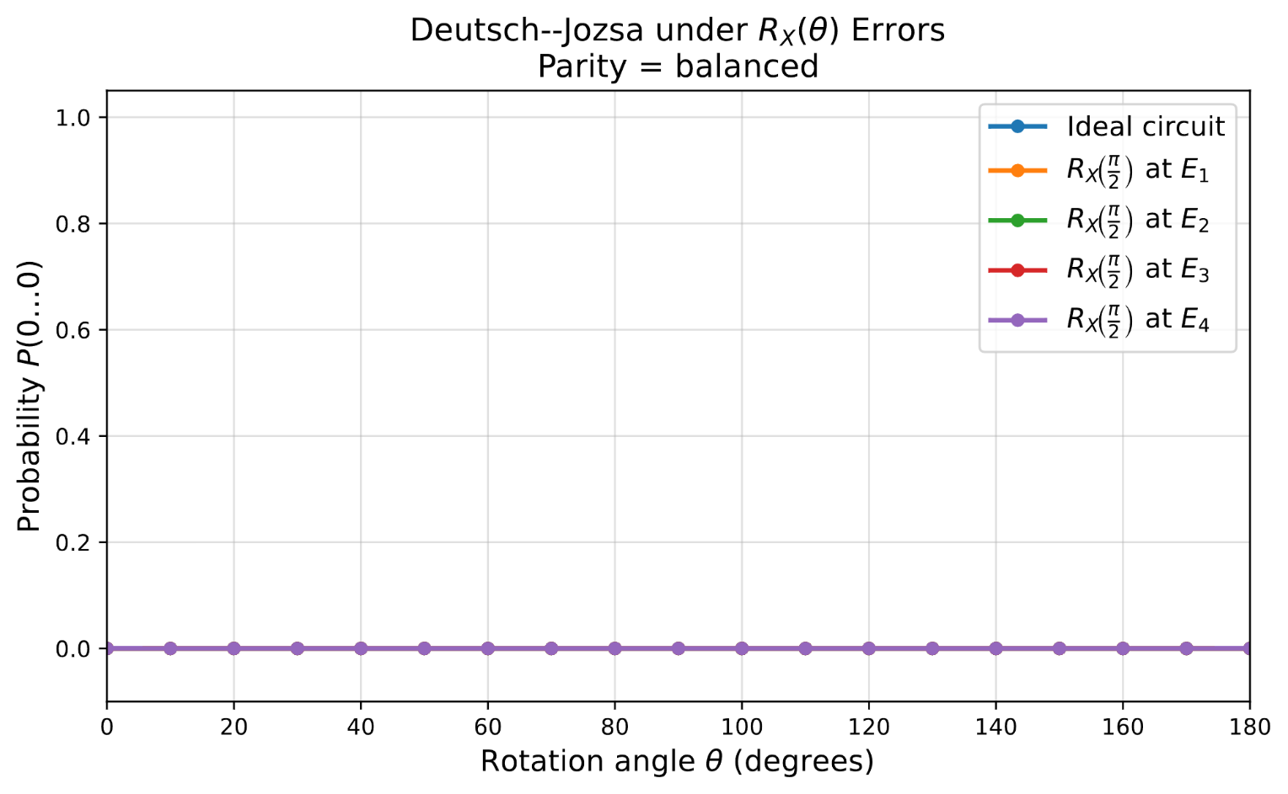
Continued…
X-axis rotation · balanced
•
P(0ⁿ) remains approximately zero for all locations and angles.
•
All curves overlap with the ideal balanced result.
•
This metric does not reveal changes among nonzero bit strings.
Each plotted rotation uses the angle sweep θ = 0°…180°
20

Slide 21

Continued…
Y-axis rotation · balanced
•
The all-zero probability stays at numerical zero.
•
No axis–location dependence appears in P(0ⁿ).
•
A full-distribution metric is needed to test whether other outputs changed.
Each plotted rotation uses the angle sweep θ = 0°…180°
21

Slide 22
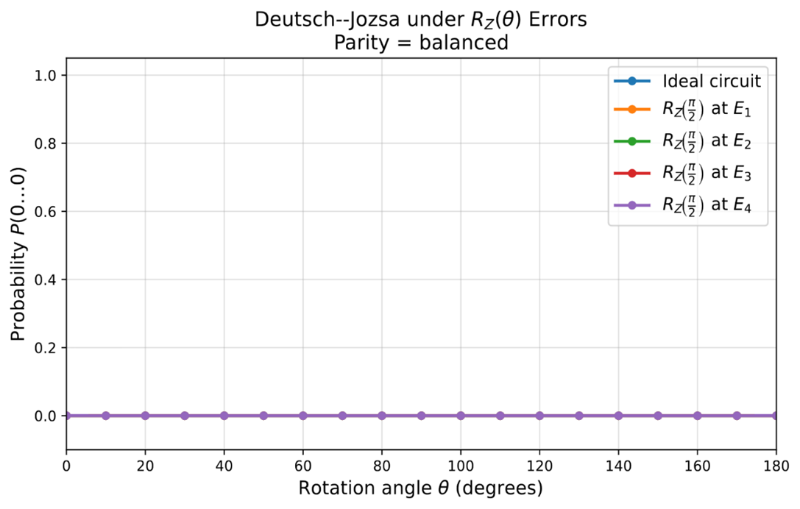
Continued…
Z-axis rotation · balanced
•
P(0ⁿ) remains approximately zero throughout the sweep.
•
The decision rule still reports balanced.
•
Stable classification does not imply that the complete output state is unchanged.
Each plotted rotation uses the angle sweep θ = 0°…180°
22

Slide 23
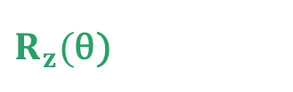
Cross-Result
Each axis has a distinct vulnerability map
Rotation
E₁
E₂
E₃
E₄
Rₓ(θ)
HIGH
LOW
LOW
HIGH
Rᵧ(θ)
HIGH
HIGH
HIGH
HIGH
$R_{z}($θ)
LOW
HIGH
HIGH
LOW
Interpretation
X errors attack circuit boundaries; Z errors attack the interference region; Y errors affect all stages.
23

Slide 24
Scope and Limitations
The conclusions are precise
What this study establishes
What it does not claim
•
Axis and circuit position jointly determine coherent-error sensitivity.
•
No depolarizing, damping, decoherence, or stochastic-noise model.
•
The pattern repeats across both constant functions.
•
One selected input qubit; no correlated or multi-qubit errors.
•
Balanced classification is stable under the selected metric.
•
P(0ⁿ) does not expose redistribution among nonzero outcomes.
Experimental scope
Simulation with 1024 shots; hardware drift and device-specific calibration are not modeled.
24

Slide 25
Conclusions
Error mitigation should be matched to the error mechanism
X
Protect preparation and pre-measurement stages
E₁ and E₄
Y
Treat the circuit as uniformly exposed
E₁–E₄
Z
Protect the phase-sensitive interference region
E₂ and E₃
25

Slide 26
Thank You
Questions?

